Slide 1
Python with Plotly and Dash
Instructor - Kritika Versha

Slide 2
Pre-requisites
Programming knowledge in Python
Experience working with Pandas library
Experience working with Numpy library
Experience with basic HTML

Slide 3
Topics covered in this training
Day 1
Plotly in Python - Introduction
Dash - Brief Introduction
Dash - Open Architecture (general and for python)
Inside app.py file
Introduction to Dash Components
Plotly Graph Objects
Plotly Express
Basic Callbacks
Advanced Callback functions
Sharing data between callback functions

Slide 4
…..continued
Day 2
Introduction to Dash Editable Tables
Overriding stylesheets, theming and template creation
Hands-on project based on Plotly’s Uber Rideshare demo
Integrating React components with Dash

Slide 5
Installation Guide
In this course, we will be using Jupyter notebooks and spyder from Anaconda Navigator. Trainees will be provided with sessions that have pre-installed software and libraries.
However, feel free to use other IDEs.
Library Installations
dash- v2.0.0
jupyter_dash
plotly
pandas
numpy
multiprocess
diskcache
Psutil
cookiecutter
node/node.js (installation varies depending on OS)

Slide 6
Introduction to Plotly
Plotly is an organization that develops analytical and visualization tool.
Products by Plotly
Plotly Javascript Graphing Library (plotly.js)
Dash (Community and Enterprise versions)
ChartStudio (Community and Enterprise versions)

Slide 7
Introduction to Dash
Written on top of plotly.js and React
Abstracts protocols needed to build full-stack app so that developers can customize them.
Available as libraries and packages in python, R, Julia, Matlab
Dash apps are rendered in web-browser
Dash apps can be deployed on virtual machines/Kubernetes.
Dash apps are cross-platform and mobile friendly

Slide 8
Dash in Python (Open-source)
Dash is a Python framework for building web applications.
Created and maintained by Plotly.
Written on top of Flask, Plotly.js, and React.js.
Dashboard is implemented in pure Python.
Concurrency - Multi-user Application

Slide 9
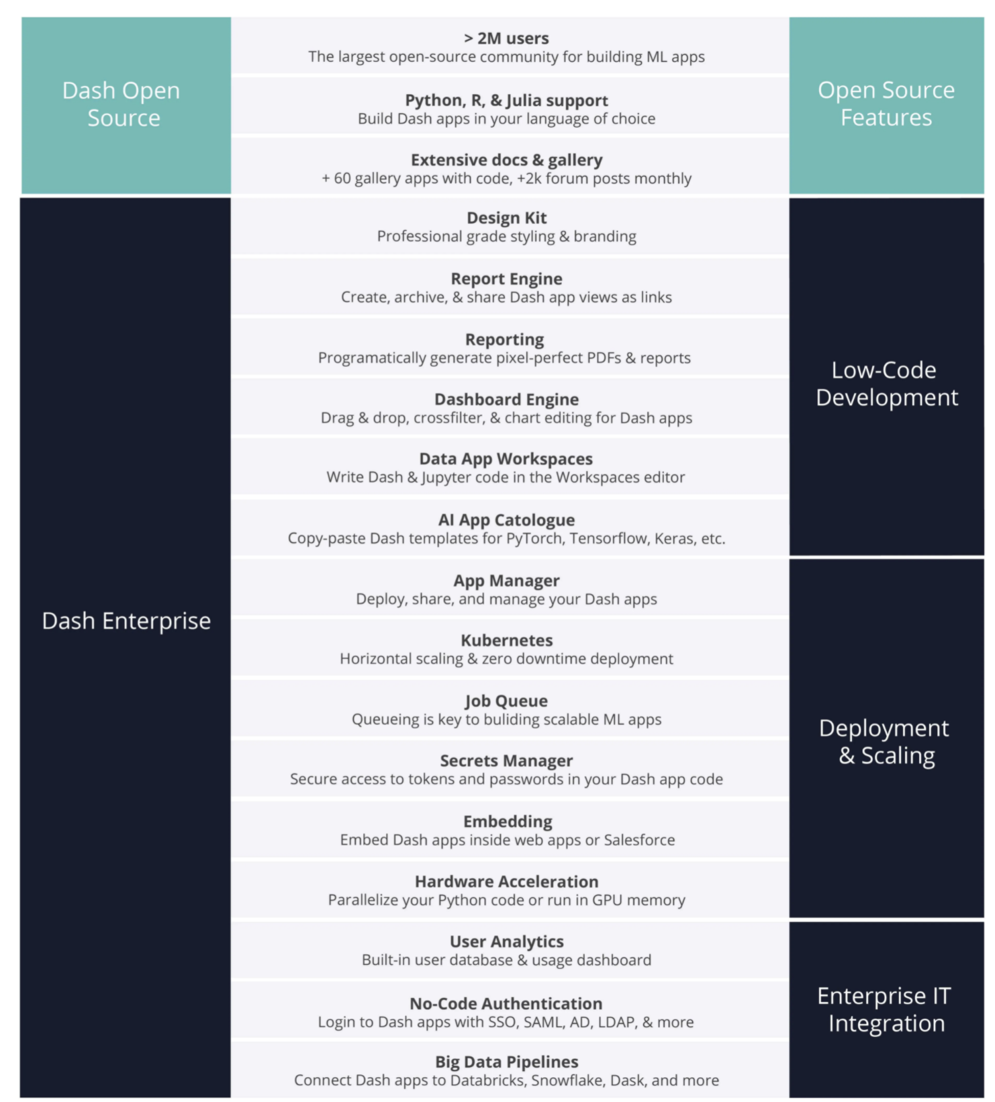
Dash - Open Source vs Enterprise

Slide 10
Dash Architecture in Python
Applications run on Flask web application framework.
Communication happens using JSON payloads via http packets
Underlying instance of Flask and all of its configurable properties is accessible to Dash app developers
Dash apps can be extended through the rich set of Flask Plugins
Front-end renders components using React
Hot-reloading (default/optional)

Slide 11
Dash App Structure - Inside app.py file
LAYOUT
Dash Core Components
Dash HTML Components
Graph components using Plotly compatible data structures
Data Tables
Bootstrapping Components
CSS Default Styling, DAQ
Custom React Components
CALLBACKS
Single i/p - Single o/p
Multiple i/p - Single o/p
Single i/p - Multiple o/p
Multiple i/p - Multiple o/p
Chained
Circular
Long
State dependencies
run_server() / gunicorn (for production)

Slide 12
Dash Components
Dash Core Components -> Interactive HTML elements implemented in dash-core-components
HTML Components -> Component class for every HTML tag as well as keyword arguments for all of the HTML arguments implemented in dash_html_components package
Plotly python API implemented in dash-core-components is available through Graph class

Slide 13
Dash HTML Components
The layout is composed of a tree of "components" such as html.Div and dcc.Graph.
The dash_html_components (dash.html as of Dash v2.0) function has a component for every HTML tag.
Not all components are pure HTML. The dash_core_components describe higher-level components that are interactive and are generated with JavaScript, HTML, and CSS through the React.js library.
Each component is described entirely through keyword attributes. Dash is declarative: you will primarily describe your application through these attributes.

Slide 14
Assignment 1
Open the notebook: a1_dcc_core_comp.ipynb

Slide 15
Plotly - Figures and Graphs
Plotly.js
Built on top of d3.js and stack.gl
High-level declarative charting library.
Free and open source
Plotly in Python
Graphs are rendered by data structure also known as figures
Figures are represented as dictionaries or instances of plotly.graph_objects
Rendering process uses Plotly.js library under the hood

Slide 16
Graph Objects
API References: https://plotly.com/python-api-reference/generated/plotly.graph_objects.Figure.html
plotly.graph_objects module are typically imported as go
contains an automatically-generated hierarchy of Python classes
classes represent non-leaf nodes in this figure schema
term "graph objects" refers to instances of these classes
primary classes defined in the plotly.graph_objects module are Figure
an ipywidgets-compatible variant called FigureWidget also exists for plotting figures (not covered in the training)
Instances of these classes have methods like add_trace(), update_layout(), show(), write_html(), write_json() etc.

Slide 17
Graph objects continued….and plotly express
Graph objects provides users with customizing plot ability
Dataset used from: https://plotly.com/python-api-reference/generated/plotly.express.data.html
add_trace: New traces can be added to a graph object figure using the add_trace() method. This method accepts a graph object trace (an instance of go.Scatter, go.Bar, etc.) and adds it to the figure. This allows you to start with an empty figure, and add traces to it sequentially. The append_trace() method does the same thing, although it does not return the figure.
Trace type reference: https://plotly.com/python/reference/?_ga=2.10538674.704611116.1633196374-2052468828.1630691380
Plotly Express is built on top of graph objects which provides users an ability to create graphs with less lines of code.

Slide 18
Assignment 2
Open the notebook: a2_dcc_graph_data_table.ipynb

Slide 19
Graph objects vs Plotly Express
Graph Objects
Good
Graph objects provide the ability to customize plots. It is not always possible to provide deep customizations using plotly express in comparison with graph objects.
Bad and Ugly
Implementation is a multi- line code in comparison with plotly express
Plotly Express
Good
The entire visualization can be created with one line of code (kind of).
You can animate change.
You can isolate certain information
It’s interactive
Bad
Plotly Express is still relatively new, so there’s not a lot of online help available.
You need to set the color every single time you create a new graph.
Ugly
Styling limitations

Slide 20
Sharing Plots and Reports
Using ChartStudio
- to save your plots
- save them as static files as export them
- create urls/links.
Plotly Express - HTML file example -> plotly.offline.plot(fig, filename='')
Plotly Express - Generating URL -> url=py.iplot(fig,filename='your_filename', auto_open=[True,False])

Slide 21
Dash Extensions and Leaflet
dash_extensions
The snippets module -> collection of utility functions
The javascript module -> functionality to ease the interplay between Dash and JavaScript
The enrich module -> enriched versions of Dash components
The multipage module -> utilities for multi page apps
A number of custom components, e.g. the Download component
dash-leaflet
light wrapper around React-Leaflet to be utilized in dash for geo-json objects
dash_daq
comprises a robust set of controls that make it simpler to integrate data acquisition and controls into your Dash applications

Slide 22
What are callbacks?
Callback functions are the most important elements in Dash that make your visualizations interactive. They are ways to update different elements dynamically on the fly.

Slide 23
How do callback functions work? What are Dash dependencies?
Callbacks need the component id and component property of your input and output components.
You need to then create a function which you can customize to return an output to the location of the output component id.
You need to wrap around a callback decorator to know that it is a call back function. This decorator differentiates a callback function from regular functions
Callback functions are defined outside the app layout.
In some cases, you might have a "form"-like pattern in your application. In such a situation, you may want to read the value of an input component, but only when the user is finished entering all of their information in the form rather than immediately after it changes.

Slide 24
When are callback functions called?
When A Dash App First Loads
As a Direct Result of User Interaction
As an Indirect Result of User Interaction
When Dash Components Are Added To The Layout

Slide 25
Assignment 3
Open the notebook: a3_basic_dash_callbacks.ipynb

Slide 26
DAY 2

Slide 27
Assignment 5
Advanced callbacks.
Open the notebook: a5_advanced_dash_callbacks.ipynb

Slide 28
More on callbacks
When python app.py or gunicorn app:server is run, all of the files in a Dash app are executed. You can provide data via a periodic task or by setting app.layout as a function to regenerate the layout with each page load.
This list of callbacks is only provided at page load and can't be modified later, so the app needs to know about all of its callbacks from the beginning even for components that do not exist in the initial layout.
Dash-renderer recursively collects not only those callbacks whose inputs can be changed directly through user interaction, but also those callbacks whose inputs are outputs of another callback that has already been collected.

Slide 29
…..callbacks(continued)
If a Dash app has multiple callbacks, the dash-renderer requests callbacks to be executed based on whether or not their inputs might be changed as a result of another callback.
Components in the layout communicate with the dash-renderer whenever their state changes. When this occurs, the dash-renderer looks to see which callbacks need to be executed as a response to the user input. This can include both callbacks that use the input directly and callbacks whose inputs are outputs of callbacks that use the input directly.
It is possible for new components to be added to the app.layout dynamically as the output of a callback. If these new components are themselves inputs to callback functions, then their appearance in the layout triggers the execution of those callbacks.

Slide 30
So, how do we share data between callbacks?
In order to share data safely across multiple Python processes or servers, we need to store the data somewhere that is accessible to each of the processes.
There are three main places to store this data:
In the user's browser session via dcc.Store
On the disk (e.g. on a file or in a database)
In server-side memory shared across processes and servers like a Redis database. Dash Enterprise includes onboard, one-click Redis databases for this purpose.

Slide 31
Sharing data between callbacks
But we can use global variables, right?
Dash is stateless. With a stateless framework, user sessions are not mapped 1-1 with server processes. Each callback request can be executed on any of the available processes
Dash is designed to work in multi-user environments where multiple people may view the application at the same time and will have independent sessions.
If your app uses modified global variables, then one user's session could set the variable to one value which would affect the next user's session.
Dash is also designed to be able to run with multiple python workers so that callbacks can be executed in parallel.

Slide 32
Overriding the defaults
To add your own local CSS & Javascript and Overriding Page-load Template
Create a folder named ‘assets’ in your dash project. Dash will serve all the .css and js files from this folder by default
To point to other folders, use ‘assets_url_path’ in dash.Dash argument
Adding external CSS and Javascript
external_scripts -> Users should be able to pass in external javascript scripts with external_scripts parameter inside dash.Dash(__name__)
external_stylesheets -> Users should be able to pass in external .css files with external_stylesheets parameter inside dash.Dash(__name__)
The dcc.Graph component leverages the Plotly.js library to render visualizations. The dcc.Graph component comes with its own version of the Plotly.js library, but this can be overridden by placing a Plotly.js bundle in the assets directory.

Slide 33
Customizing Dash's HTML Index Template
Dash's UI is generated dynamically with Dash's React.js front-end. So, on page load, Dash serves a very small HTML template string that includes the CSS and JavaScript that is necessary to render the page and some simple HTML meta tags. To customize the index page, there are 3 available options:
Use ‘app.index_string’ to modify the default HTML index template

Slide 34
Customizing Dash Renderer using hooks
app.renderer = '''
var renderer = new DashRenderer({
request_pre: (payload) => {
// print out payload parameter
console.log(payload);
},
request_post: (payload, response) => {
// print out payload and response parameter
console.log(payload);
console.log(response);
}
})
'''
request_pre: takes the payload of the request being sent as its argument
request_post: takes both the payload and the response of the server as arguments.

Slide 35
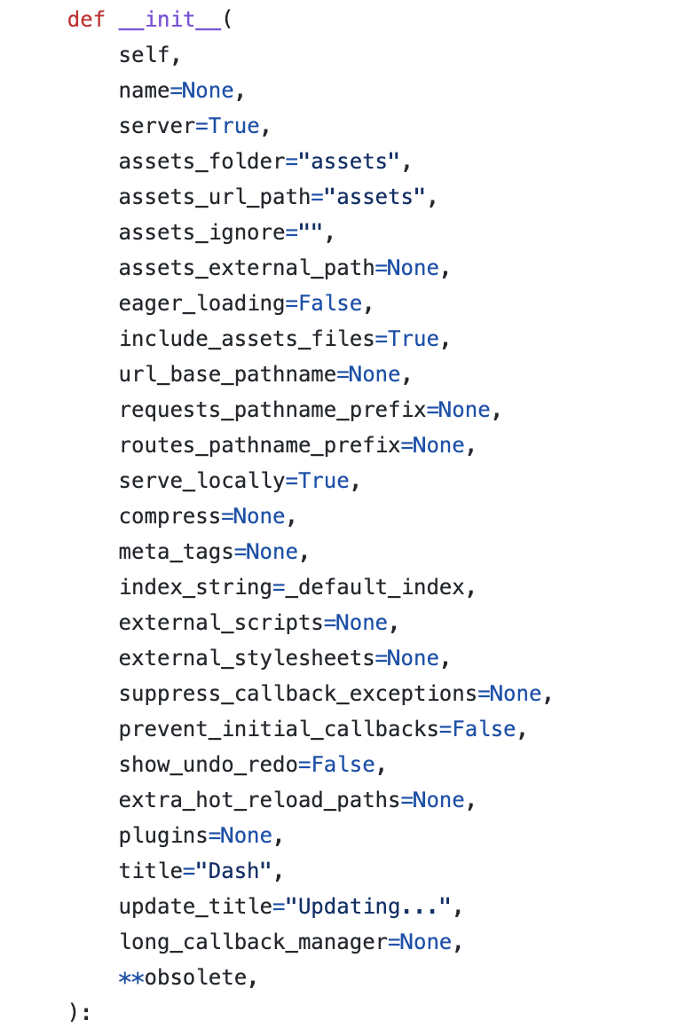
More customizations

Slide 36
Dash Data Tables
Interactive table component designed for viewing, editing, and exploring large datasets

Slide 37
Styling Features of Dash Data Tables
Updating table height
Updating table width and columns
Styling
Conditional formatting
Number formatting
Sorting filtering and paging
Adding Datatable Tooltips

Slide 38
Assignment 4
Open the notebook: a4_editable_dash_tables.ipynb
Documentation Reference: https://dash.plotly.com/datatable/reference

Slide 39
Building your own Dash components
Components in Dash are serialized as JSON.
Annotating components with React docstrings - React Docgen.
At build time, Dash reads this JSON file and dynamically creates Python classes that subclass a core Dash component.
MANIFEST.in needs to contain each JavaScript, JSON, and CSS file that you have included in your my_dash_component/ folder. In the dash-component-boilerplate repository, you can see that all the JavaScript for your React component is included in the build.js file.
The Dash app crawls through the app's layout property and checks which component packages are included in the layout; then it extracts that component's necessary JavaScript or CSS bundles. Dash serves these bundles to Dash's front-end. These JavaScript bundles are used to render the components.
Dash's layout is serialized as JSON and served to Dash's front-end. This layout is recursively rendered with these JavaScript bundles and React.
Checkout python package: cookiecutter: https://github.com/plotly/dash-component-boilerplate
Examples:
- https://blog.ag-grid.com/react-get-started-with-react-grid-in-5-minutes/
- https://jackylishi.medium.com/build-a-realtime-dash-app-with-websockets-5d25fa627c7a
- https://dash.plotly.com/dash-ag-grid/usage

Slide 40
Uber Rides - Project
Read the Project-Uber_Ride.pdf document and follow the instructions.
Open project-uber-ride folder.
Create a file named app.py

Slide 41
Dash App Deployment
Files needed for deployment:
sample app (app.py) - Application code
.gitignore file - The . gitignore file tells Git which files to ignore when committing your project to the GitHub repository. gitignore is located in the root directory of your repo.
requirements.txt - describes your Python dependencies.
Procfile - specifies the commands that are executed by the app on startup

Slide 42
Procfile
Your app’s web server
Multiple types of worker processes
A singleton process, such as a clock
Tasks to run before a new release is deployed

Slide 43
References
Dash backend: https://github.com/plotly/dash
Dash frontend: https://github.com/plotly/dash-renderer
Dash core component library: https://github.com/plotly/dash-core-components
Dash HTML component library: https://github.com/plotly/dash-html-components
Dash docs and user guide: https://github.com/plotly/dash-docs, hosted at https://plot.ly/dash
Plotly.js — the graphing library used by Dash: https://github.com/plotly/plotly.js

Slide 44
References
List of all dash core components (community version): https://dash.plotly.com/dash-core-components
List of all dash html components: https://dash.plotly.com/dash-html-components
Documentation for properties can be accessed using the command: help(dash.html.[add-component-name]) in python or help(dash.dcc.[add-component-name]) here (for properties of input component)
dash_extensions:https://pypi.org/project/dash-extensions/
Dash bootstrap components: https://dash-bootstrap-components.opensource.faculty.ai/
Dash Leaflet: Dash bootstrap components: https://dash-leaflet.herokuapp.com/

